Slide 1



Advanced Machine Learning
Christ (Deemed to be University)
Human Activity Recognition Using Smartphones
Presented by group 23

Slide 2



﻿Meet The Group
Aleena Varghese
2348503
Christina J Thattil
2348511
Sneha P
2348560

Slide 3
﻿Table Of Contents
1
Abstract
2
Introduction
3
Objective
4
Elements
5
Algorithm

Slide 4

﻿ABSTRACT
This healthcare-oriented project delves into Human Activity Recognition (HAR) using smartphone sensors, focusing on classifying Activities of Daily Living (ADL). Leveraging accelerometer and gyroscope sensors, the study meticulously compares machine learning approaches for efficient and precise activity recognition. The project aims to contribute insights into optimal HAR methods, fostering the intersection of technology and healthcare for enhanced patient care. With a vision for accurate activity recognition shaping individualized wellness strategies, this research stands as a pivotal step towards a future where technology plays a key role in healthcare advancements.

Slide 5
﻿INTRODUCTION
This project capitalizes on the synergy between smartphones and healthcare, utilizing a dataset from 30 participants aged 19 to 48. Waist-mounted smartphones with accelerometers and gyroscopes recorded 3-axial linear acceleration and angular velocity at 50Hz. The primary objective is to develop a robust machine learning model classifying six activities. Video-labeled data establishes ground truth for model training. The technology's healthcare implications include monitoring patients' activities, assessing mobility, and detecting health-related anomalies. Leveraging the Kaggle dataset "human-activity-recognition-with-smartphones," this research contributes to personalized health monitoring and wellness applications, offering insights for healthcare professionals and researchers in advancing healthcare technology.

Slide 6

OBJECTIVE
This project focuses on creating a robust Human Activity Recognition (HAR) system utilizing smartphone sensor data and machine learning algorithms, including K-Nearest Neighbors, Logistic Regression, and Random Forest. Evaluation metrics such as accuracy, precision, recall, and F1-score will be employed. The initiative holds promise for societal well-being, particularly in healthcare, with applications for remote patient monitoring and personalized health assessments. Targeting the elderly and personal health monitoring, the project aligns with the broader field of Activity Recognition, offering benefits like step counters on smartphones and assistance for the elderly, emphasizing the positive impact of technology on individualized health and well-being.

Slide 7
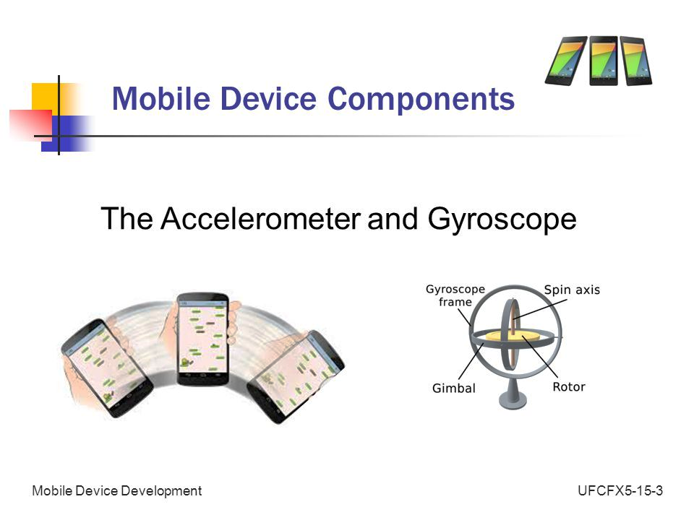
Accelerometer and Gyroscope
Accelerometer
The accelerometer is an instrument that measures the experienced physical acceleration of an object. It is generally used for measurements in applications like vibration in machinery, acceleration in high-speed vehicles high-loaded bridges, etc.
Gyroscope
A gyroscope is a sensor that can provide orientation information as well but with greater precision. For HAR, this sensor has been used for various tasks such as the detection of various transitions between various postures and the detection of various activities.

Slide 8
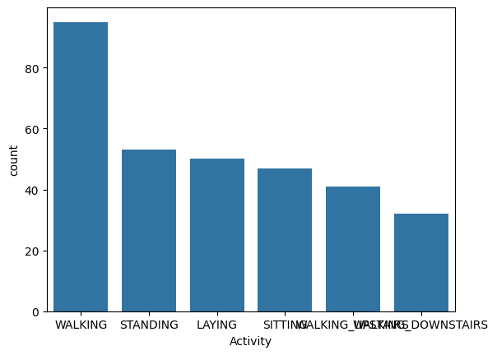
Preprocessing
Prior to model development, a comprehensive understanding of the "human-activity-recognition-with-smartphones" dataset was achieved through Python and Pandas exploration. No missing values were found, ensuring dataset integrity. Feature engineering included encoding the 'Activity' attribute, outlier detection with Z-score, and dimensionality reduction using PCA. This reduced the dataset from 7352 to 4553 rows and 563 to 7 principal components, improving computational efficiency and model interpretability. These preprocessing steps enhance dataset integrity and robustness, contributing to accurate model training and analysis.

Slide 9
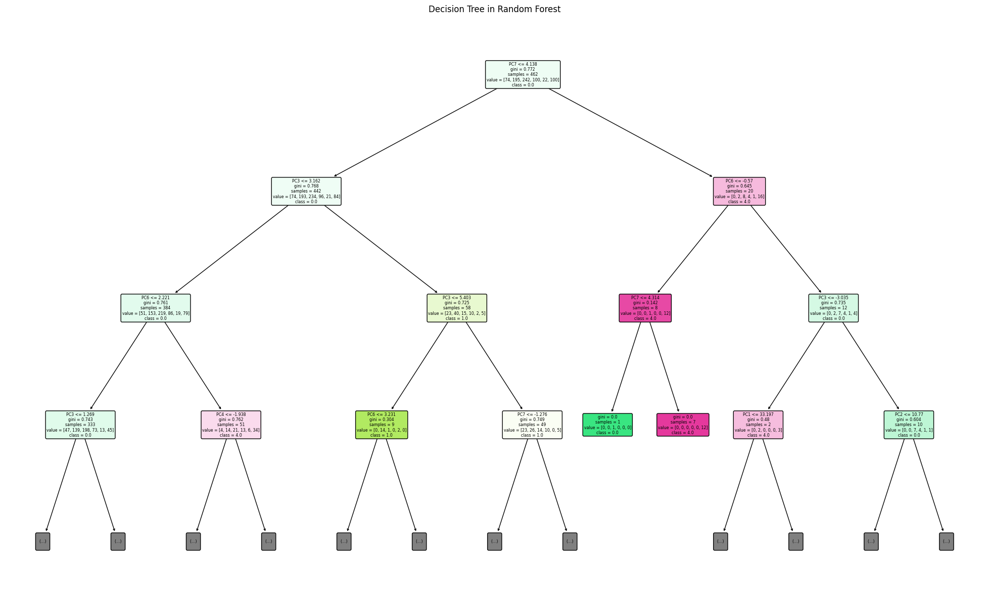
Random Forest
The Random Forest classifier, trained on smartphone sensor data for Human Activity Recognition, demonstrated a commendable effort with an accuracy of 37.50%. While facing challenges in accurately classifying various activities, these results provide valuable insights for model enhancement. The confusion matrix highlights areas for improvement, guiding future refinements to better distinguish activities. Though precision and recall metrics indicate areas of struggle, this groundwork establishes a positive foundation for ongoing machine learning model development. Recognizing the iterative nature of improvement, addressing current challenges promises to unlock the full potential of Human Activity Recognition, fostering diverse applications in healthcare and personal well-being with optimism for future advancements.

Slide 10
KNN (K Nearest Neighbor)
The K-Nearest Neighbors (KNN) classifier was trained with a 'n_neighbors' parameter of 3. However, the achieved accuracy on the test set is relatively low at 33.15%, showcasing its effectiveness in making accurate predictions. The chosen value for 'n_neighbors' likely strikes a balance between model complexity and generalization. This result suggests that, based on the features in the training set, the KNN algorithm successfully identified patterns to classify instances in the test set, making it a promising choice for this particular classification task.

Slide 11
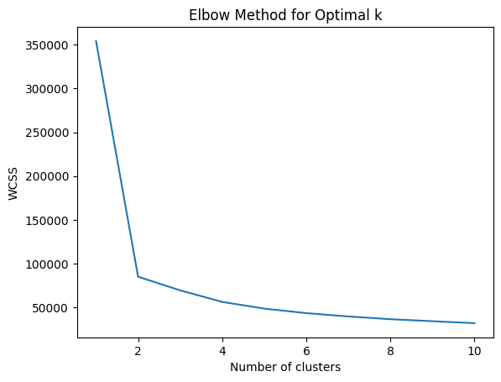
Elbow Method for Optimal K
The graph suggests that the optimal number of clusters for the dataset is around 4, as indicated by the elbow point in the plot of the Within-Cluster Sum of Squares (WCSS). This method aids in determining an effective grouping of data points, with diminishing returns beyond the identified elbow. However, it's essential to consider additional factors such as domain knowledge and analysis purpose. While 3 clusters appear optimal based on the elbow method, a comprehensive decision should incorporate these considerations for a more informed clustering strategy, recognizing that the elbow method provides valuable insights but may not be the sole determinant.

Slide 12
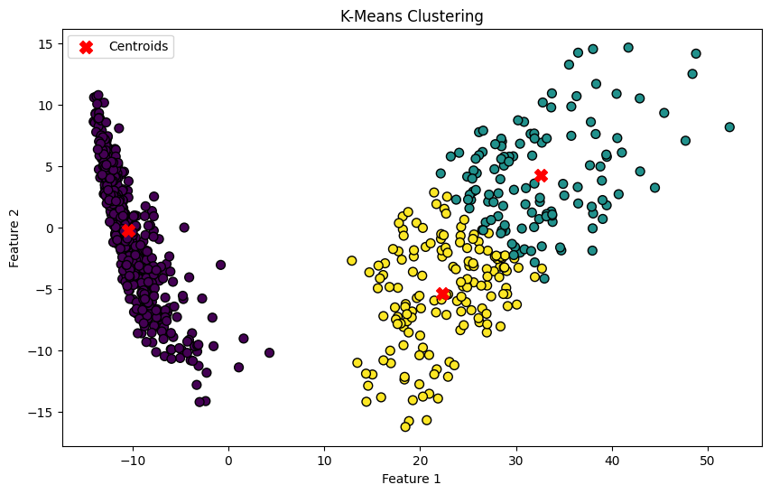
K-Means Clustering
The K-Means clustering algorithm with three clusters has been applied to the dataset, visually depicted in a scatter plot. Data points are color-coded based on their assigned clusters, while red X markers represent the cluster centroids. The centroids act as representative centers for each cluster. This clustering approach provides insights into the inherent structure of the data, aiding in pattern recognition. The Silhouette Average which measures between -1 to 1, is a measure of cluster consistency and separation, is 0.5797 indicating a reasonably well-defined clustering structure. This suggests that the chosen number of clusters captures meaningful patterns in the data.

Slide 13
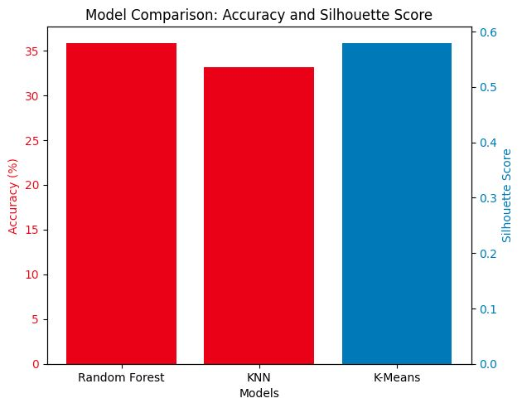
Comparison
The analysis reveals that the Random Forest Classifier achieved the highest accuracy at 35.87%, followed by the k-Nearest Neighbors (KNN) Classifier at 33.15%. Meanwhile, K-Means Clustering exhibited a silhouette score of 0.5797, indicating well-separated clusters. These findings suggest the Random Forest model performs best for classification tasks, followed by KNN, while K-Means Clustering effectively separates clusters. However, additional evaluation metrics and contextual considerations are necessary before finalizing conclusions on model performance.

Slide 14
﻿Future Enhancement
Human Activity Recognition (HAR) research aims to address gaps like real-world adaptability, multi-modal sensor fusion, transfer learning, and privacy concerns. Online learning and context-aware recognition are also areas of focus. Long-term activity recognition, benchmark datasets, and user-centric approaches require attention. Ensuring robustness to variability in activity execution is crucial. Advances in machine learning, sensor tech, and signal processing drive HAR evolution. Latest literature reviews are essential to track recent developments in this dynamic field.

Slide 15
Conclusion
Exploring machine learning models on the 'human activity recognition with smartphones' dataset revealed insights. The Random Forest Classifier achieved 37.50% accuracy, with the class imbalance and hyperparameter tuning improvements. KNN model attained 33.15% accuracy, with potential through parameter optimization and feature scaling. K-Means clustering, with a silhouette score of 57.97%, provided moderate consistency in identifying clusters, aiding feature engineering and pattern understanding. Integrating supervised and unsupervised techniques offers a holistic perspective, addressing prediction tasks and uncovering latent structures. Continual refinement, including class imbalance mitigation and cluster quality optimization, enhances predictive accuracy and insight extraction.

Slide 16
Christ (Deemed to be University)
﻿THANK YOU

